Slide 1
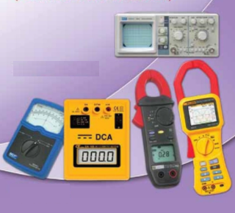
ELECTRONIC MEASUREMENTS
AND INSTRUMENTATION
Instructor: Mr. B.ManiKanth, Assistant Professor
Department of Electronics and Communication Engineering

Slide 2
UNIT IV
AC Bridges : Measurement of inductance- Maxwell’s bridge, Anderson bridge. Measurement of capacitance - Shearing Bridge. Wheat stone bridge. Wien Bridge, Errors and precautions in using bridges. Q-meter.

Slide 3
Electronic Measurements and Instrumentation
UNIT-IV
AC BRIDGES

Slide 4
Introduction to Bridge
A bridge circuit in its simplest form consists of a network of four resistance arms forming a closed circuits , with a dc source of current applied to two opposite junctions and a current detector connected to other 2 junctions.
Bridge circuits are extensively used for measuring R, L and C. Since the bridge circuit merely compares the value of on unknown component with that of an accurately known component its measurement accuracy can be very high.

Slide 5
Types of bridges
1.DC bridges -> Excited by DC source, used for measurement of unknown resistance.
2. AC bridges -> Excited by AC Source, used for measurement of
Impedance, inductance and capacitance
DC bridges
Wheat stone bridge(Resistance)
Kelvin’s bridge(Resistance)
Kelvin’s double bridge(Resistance)
Maxwell’s Bridge(Inductance)
AC bridges
Anderson bridge(Inductance)
Shearing bridge(Capacitance)
Wien bridge(Frequency)

Slide 6
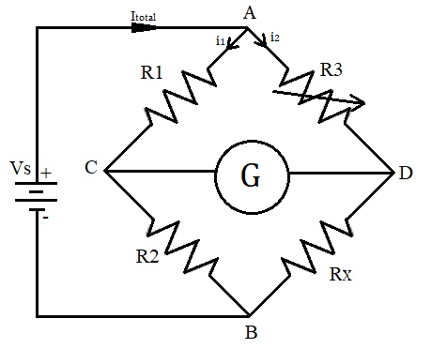
DC Bridge(Wheatstone’s bridge)

Slide 9
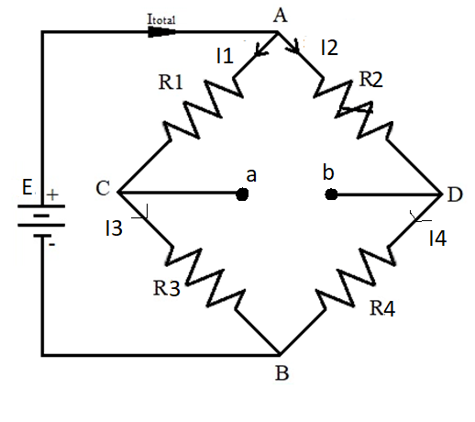
Unbalanced Wheatstone bridge
To determine the amount of deflection that would result for particular unbalance we shall use
thevenin’s theorem
thevenin’s eq’ voltage can be determined by disconnecting the galvanometer from the bridge and determining the open circuit voltage between a & b
Applying voltage divider equation , Voltage at point a
E_{C} = (E * R₃)/ R₁ + R₃ similarly
E_{D} = (E * R₄) / R₂ + R₄

Slide 10
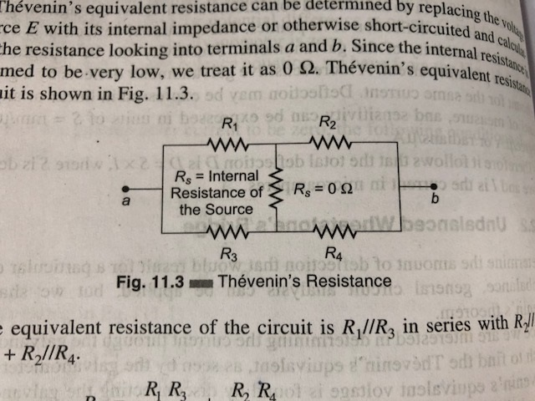
Unbalanced Wheatstone bridge
Eth = Eab= Ea – Eb = E[R3/ (R1 + R3) - R4/ (R2 + R4)]
Rth can be determined replacing E with internal impedance or otherwise short circuiting the resistance looking into terminals a & b
Since internal resistance is assumed to be very low = 0
Rth circuit can be

Slide 11
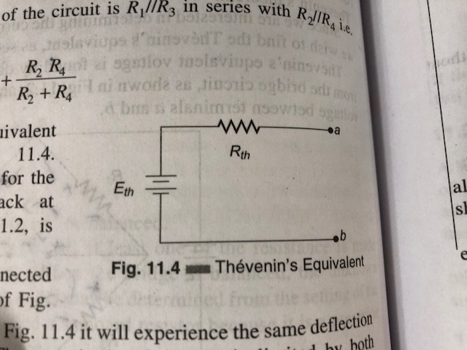
Unbalanced Wheatstone bridge
The eq resistance of the ckt is R1||R3 in series with R2||R4
Rth = R1R3/(R1+R3) + R2R4/ (R2+R4)
Therefore thevenin’s eq ckt

Slide 12
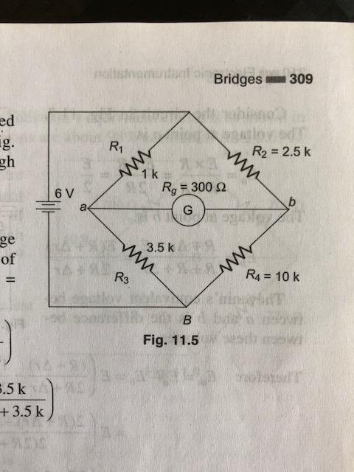
Unbalanced Wheatstone bridge
If galvanometer is connected in between a and b
The deflection current is therefore given by
Ig = Eth / Rth + Rg
Calculate the current through the galvanometer ?

Slide 13
solution
Eth = 0.132V
Rth = 2.778K
Ig = 42.88 micro A
Assignment : slightly unbalanced whetstone's bridge

Slide 14
Applications of whetstones bridge
Used to measure the DC resistance of various types of wires
Ex : resistance of motor windings
Transformers
Solenoids and relay coils
Extensively used by telephone companies and others to locate cable faults

Slide 15
Limitations of whetstone’s bridge
For low resistance measurement the resistance of leads and contacts become significant and introduces and error
For high resistance measurements the resistance presented by the bridge becomes so large that the galvanometer is insensitive to imbalance
Change in resistance of the bridge arms due to heating effect of current through the resistance

Slide 16
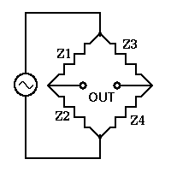
AC Bridges
Impedances at AF and RF are commonly determined by means of an AC WHEATSTONE BRIDGE
Similar to DC bridge except that the bridge arms are impedances. The bridge Is excited by ac source rather than dc source and the galvanometer is replaced by detector
When the bridge is balanced then
_ _ _ _
Z₁/Z₃ = Z₂/Z₄
_ _ _ _
Z₁,Z₂,Z₃,Z₄ are the impedances and are vector complex components that poses phase angles
Adjust both magnitude and phase of the impedance arms to achieve balance

Slide 17
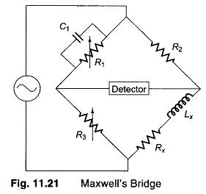
Maxwell’s bridge
Maxwell’s bridge measures the unknown inductance in terms of known capacitor
The use of standard arm offers the advantage of compactness and easy shielding.
Capacitor is almost loss less component
Balance eq. using admittance of arm 1 instead of impedance
_ _ _ _
Z₁ .Z_{x} = Z₂ .Z₃
_ _ _ _ _ _ _
Z_{x} = Z₂ Z₃/Z₁ = Z₂Z₃Y₁

Slide 18
Maxwell’s bridge Continued
Z₁ = R₁ || (1/jωC₁)
Y₁ = (1/R₁) + jωC₁
Z₂ = R₂
Z₃ = R₃
Z_{x} = R_{x} + jωL_{x}
From the above equation
R_{x} + jωL_{x} = R₂R₃((1/R1)+jωC₁) by solving this eq. and equating real and imaginary terms we get

Slide 19
Maxwell’s bridge Continued
R_{x} = R₂R₃/R₁
L_{x} = C₁R₂R₃
-> We Know that quality factor is Q = ωL_{x}/R_{x}= (ωC₁R₂R₃*R₁)/R₂R₃
Q = ωC₁R₁
_{Limitations :}
Maxwell’s eq. is limited to the measurement of low Q values and independent of excitation freq
Disadvantage of fixed capacitance is an interaction between resistance and reactance balances and can be avoided by varying the capacitances instead of R₂ and R₃
Particularly suited for inductance measurements

Slide 20
Problem on Maxwell’s bridge
A Maxwell bridge is used to measure an inductive impedance. The bridge constants at balance are
C1 = 0.001MICRO F, R1 = 470K, R2= 5.1K, R3 = 100K
FIND the series eq’ of the unknown impedance?

Slide 21
Maxwell’s bridge Problem Solution
Rx = 1.09K
Lx = 5.1 H

Slide 22
Anderson Bridge
Anderson’s Bridge is the modification of Maxwell’s inductance-capacitance bridge. In Anderson’s bridge, a standard capacitor is used for the measurement of self-inductance. The main advantage of this method is that it can be used for the wide range of self-inductance measurement.
The following figure shows Anderson’s bridge for the balance conditions.

Slide 23
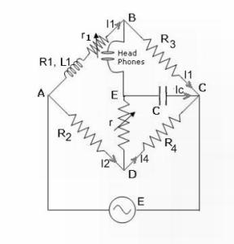
Anderson Bridge
L1 = Self-inductance to be measured,
R1 = resistance of self-inductor,
r1 = resistance connected in series with self-inductor,
r, R2, R3, R4 = known non-inductive resistances,
C = fixed standard capacitor.

Slide 24
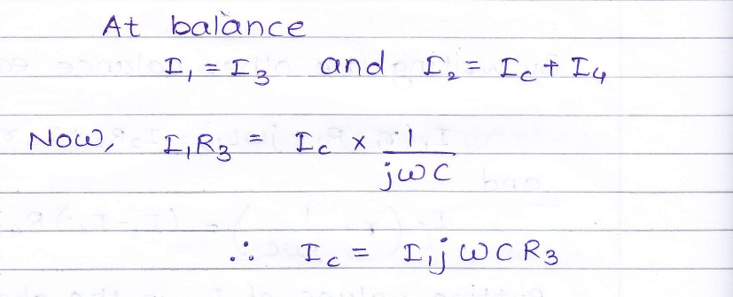
Anderson Bridge
At balance

Slide 25
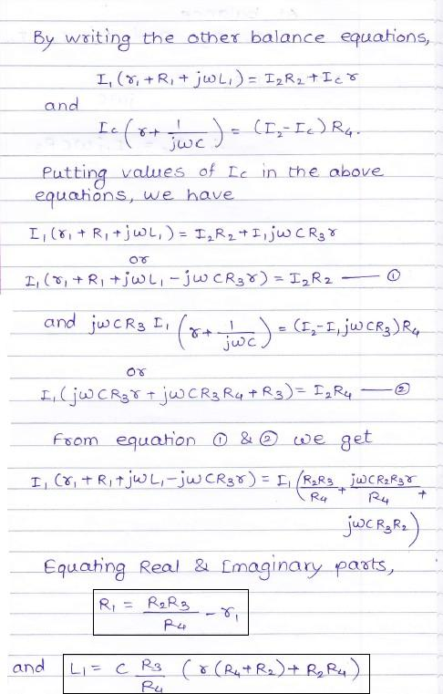
Anderson Bridge

Slide 26
Anderson Bridge

Slide 27
Anderson Bridge
Advantages of Anderson’s Bridge:
1) In Anderson’s bridge, it is very easy to obtain the balance point as compared to Maxwell’s bridge.
2) In this bridge, a fixed standard capacitor is used therefore there is no need of costly variable capacitor.
3) This method is very accurate for measurement of capacitance in terms of inductance.
Disadvantages of Anderson’s Bridge:
1) It is more complex as compared with Maxwell’s inductance bridge. It has more parts and hence complex in setting up and manipulate. The balance equations of Anderson’s bridge are quite complex and much more tedious.
2) An additional junction point increases the difficulty of shielding the bridge.

Slide 29
Calculate the unknown inductance, resistance, Quality factor of the inductor by using Hays bridge with the bridge elements as R1=5.1Kohm,R2=7.9Kohm,C1=2uF,R3=790ohm with supply frequency of 1000rad/sec

Slide 30
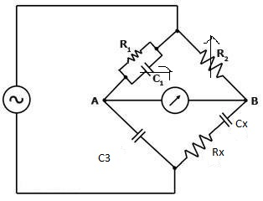
Schearing Bridge
Schearing Bridge is very important bridge used for precision measurement of capacitors and their insulating properties
C3 is a high quality mica capacitor for general measurements
For balance
Z1Zx =Z2Z3
Zx = Z2Z3/Z1
Zx = Rx – J/ ὡ Cx AND Z2 =R2
Z3 = -J/ ὡc3
Y1 =(1/R1) + j ὡ C1

Slide 31
Schearing Bridge
Zx = Z2 Z3ZY1
( Rx – J/ ὡCx) = R2(-J/ ὡC3)(1/R1+j ὡc1)
( Rx – J/ ὡCx) = R2(-j)/R1(ὡC3) + R2C1/C3
Equating real and imaginary terms
Rx = R2 C1/ C3
Cx = R1C3/ R2
The dissipation factor D of a series RC ckt is defined as cotangent of phase angle
D = ὡCxRx
D = 1/ Q

Slide 32
Schearing Bridge problem
An AC bridge has the following constants
C1 = 0.5 micro Farad
R1 = 1K , R2 = 2K,
C3= 0.5 microF frequency = 1KHz
Determine unknown capacitance and dissipation factor?

Slide 33
Schearing Bridge problem solution
Rx = 2K
Cx = 0.25 micro farad
D = 3.1416

Slide 34
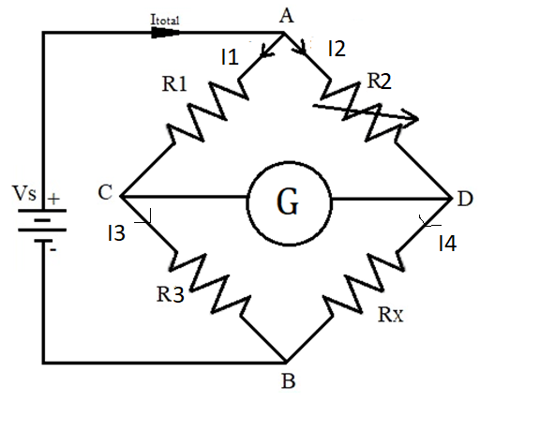
Wheatstone Bridge

Slide 35
Measurement of resistance in Wheatstone’s bridge
Between A & B source of EMF
Between C & D galvanometer (sensitive current indicating meter)
Galvanometer with zero center scale
When no current → scale = 0 I,e. in middle
Current in one direction leads the meter to deflect in one direction and current in other direction leads meter to deflect in other direction

Slide 36
Measurement of resistance in Wheatstone's bridge
Bridge is balanced when there is no current through the galvanometer (or) the potential difference at point C & D are equal
To obtain bridge balance condition
I1 R1 = I2 R2 eq → 1
For the galvanometer current to be 0 the condition is
I1= I3 = Vs/(R1+R3) & eq→ 2
I2 = I4 = Vs/(R2 + Rx) eq→3
Substitute eq 2 and 3 in eq 1 and find Rx?

Slide 37
Measurement of resistance in Wheatstone’s bridge
Rx = R2 R3/ R1
Sensitivity of Wheatstone bridge: When the bridge is in unbalanced condition current flows through galvanometer, causing deflection of its pointer . Sensitivity is thought as deflection per unit current .
A more sensitive galvanometer deflects greater amount for the same current.
Units :- S = mm/ micro A (or) degree/ micro A (or) radians/micro A
There fore total deflection D = S X I
I = current in micro amperes

Slide 38
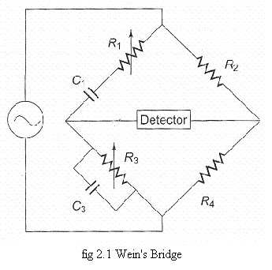
Wien’s bridge
Wien bridge in its basic form is
Designed to measure frequency
It can also be used for the
measurement of an unknown
capacitor with great accuracy
Z1 = R1 – j / ὡ C1
Y3 = 1/R3 + j ὡC3
Balanced condition
Z1Z4=Z2Z3
Z2 = Z1Z4Y3

Slide 39
Wien’s bridge
Z2 = R2 & Z4 = R4
By substituting above eq
We get R2 = R1R4/R3 + C3R4/C1 eq→ 1
(R4/ ὡC1R3)- ὡC3R1R4 = 0 ➔ eq 2
From eq ➔1 R2/R4 = R1/R3 + C3/C1
From eq→ 2 1/ ὡC1R3 = ὡ C3R1
ὡ = ? And f = ?

Slide 40
Wien’s bridge
ὡ = 1 /SQRT (C1R1 C3 R3) , f = 1/ 2pi SQRT(C1R1 C3 R3 )
PROBLEM :- find the eq parallel resistance and capacitance that causes a wien bridge to null with the following component values
R1 = 3.1K, C1 = 5.2 micro F, R2= 25K, R4 = 100K
Frequency = f = 2.5K
R3 = ? And C3 =?

Slide 41
solution
R3 = 12.4K
C3 = 20.3 Pico F

Slide 42
Precautions to be taken while using the bridge
The leads should be carefully laid out in such a way that no loops or long lengths enclosing magnetic flux are produced, with consequent inductance errors
With large L the self capacitance of the leads is more important then their inductance, so they should be placed relatively far apart
In measuring the capacitance it is important to keep the lead capacitance as low as possible
In very precise inductive and capacitance measurements leads are encased in metal tubes to shield them from mutual electromagnetic action

Slide 47
Quiz
A basic bridge consists of
a)2 arms b) 3 arms c) 4 arms d) 5 arms
Answer : option (c)
2. Wheat stone bridge is used to measure
a)Voltage b)Current c) Resistance d) power
Answer : option (c)
3. An AC bridge uses which of the following as detector
a)Headphones b)Ammeter c) voltmeter d) wattmeter
Answer : option (a)

Slide 48
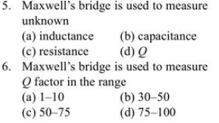

4. An AC bridge uses which of the following as detector
a)Headphones b)Ammeter c) voltmeter d) wattmeter
Answer : option (a)

Slide 49
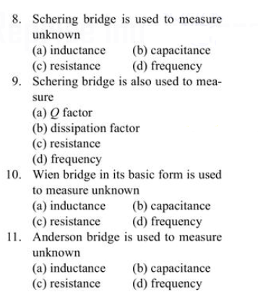

Slide 50
THANK YOU

